Slide 1
Chapter 10 Search Trees

Slide 2
Section 10.2 AVL Trees

Slide 3
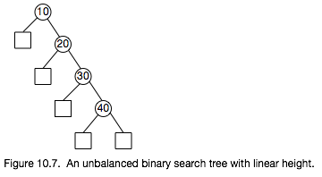
Binary Search Trees can become very unbalanced, depending upon the order in which keys are inserted.
In the worst case, when insertions are made in sorted order, the tree is no better than a linear list.
The tree can be rebalanced as nodes are inserted or removed.
One such tree is the AVL tree, named after its inventors, Adel’son-Vel’skii and Landis
The AVL tree maintains height balance, where the heights of any node’s left and right subtrees differ by no more than 1.

Slide 4
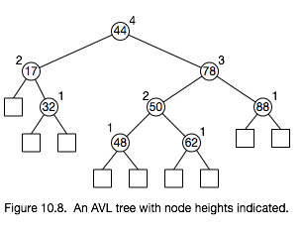

Slide 5
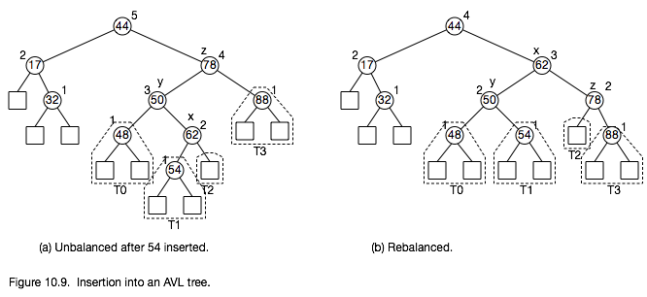

Slide 6
Trinode Restructuring
a, b, c is the inorder listing of nodes x, y, z (child, parent, grandparent)
T0, T1, T2, T3 are the left-to-right subtrees of x, y, and z
Replace the subtree rooted at z with a subtree rooted at b
Make a the left child of b
Make T0 and T1 the left and right children of a
Make c the right child of b
Make T2 and T3 the left and right children of c

Slide 7
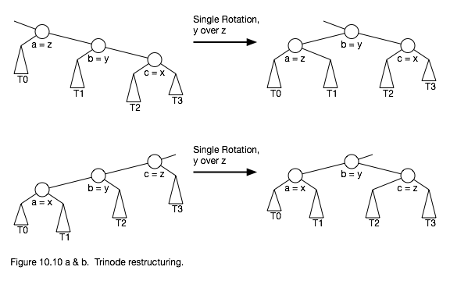

Slide 8
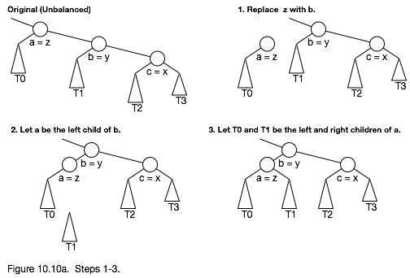

Slide 9
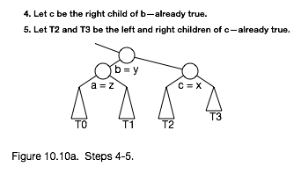

Slide 10
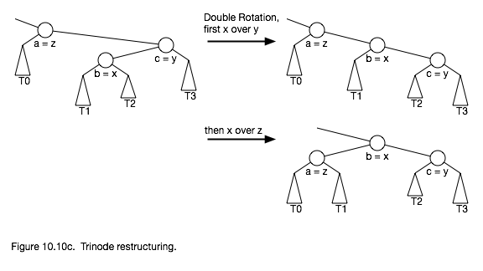

Slide 11
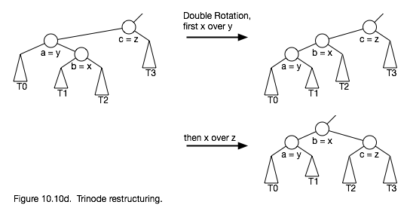

Slide 12
